Slide 1

Project title
Air quality monitoring system
Submitted in the partial fulfillment for the award of the degree of
BACHELOR OF ENGINEERING
IN
Specialization in DevOps
Submitted by:
NAME –Sandhya Kumari
UID- 22bdo10074
Under the Supervision of:
SUPERVISORS NAME :
Geetanjali Pandey
Department of AIT-CSE
DISCOVER . LEARN . EMPOWER

Slide 2
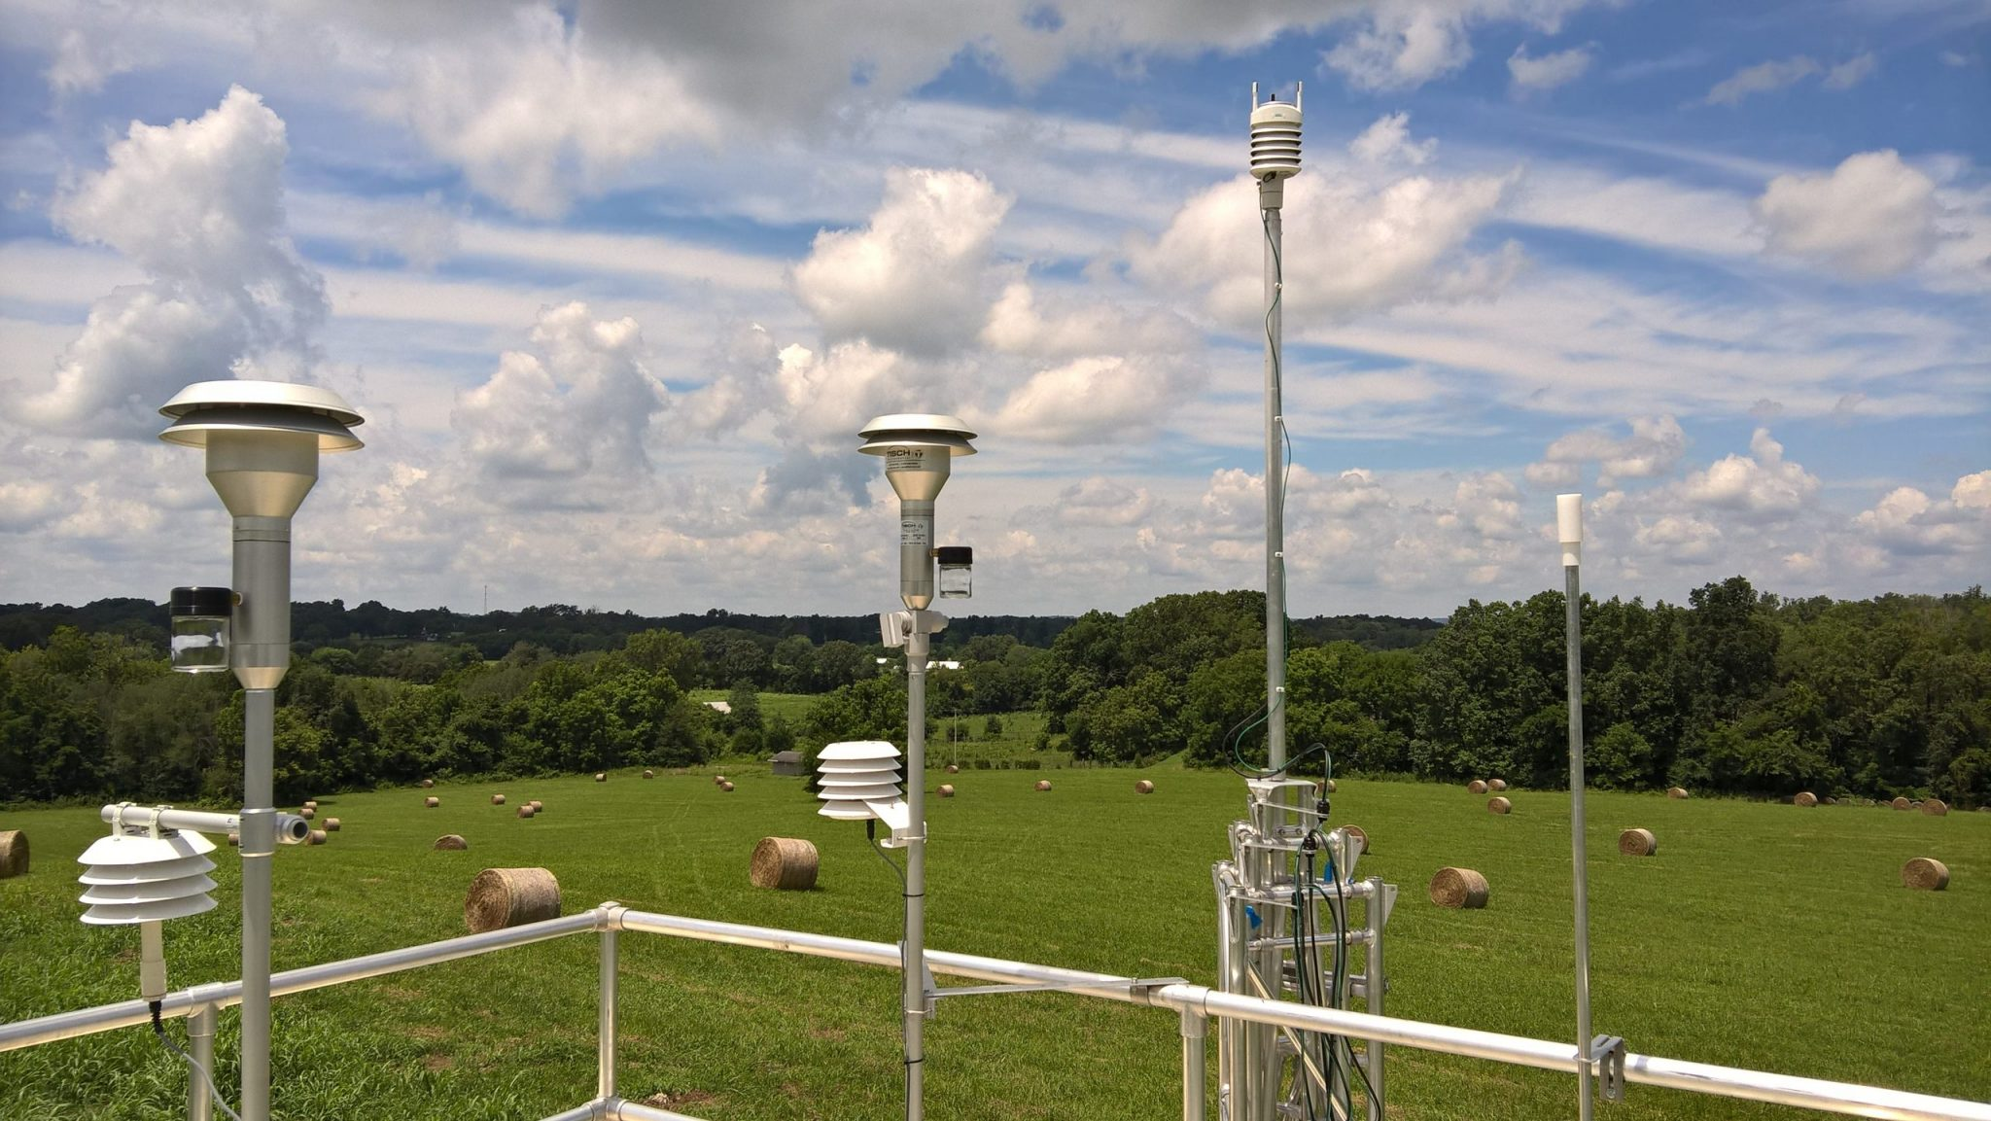
Outline for this project:
Introduction to Project
Problem Formulation
Objectives of the work
Methodology used
Results and Outputs
Conclusion
Future Scope
This Photo by Unknown Author is licensed under CC BY-SA-NC

Slide 3


Introduction
The IoT-Based Air Quality Monitoring System aims to improve environmental health by providing real-time data on air quality parameters. This system utilizes sensors to monitor pollutants and allergens in the air, enabling proactive measures to mitigate health risks.
Rising levels of air pollution and increasing occurrences of respiratory illnesses pose significant challenges to environmental health. The need for effective monitoring and mitigation strategies is crucial to safeguard public well-being.

Slide 4
Problem Formulation
One environmental issue that cannot be disregarded is air pollution.
Long-term exposure to contaminants harms people's health.
Conventional techniques for monitoring air quality, like constructing stations for the purpose, are usually costly.
Real-time monitoring of air quality is appropriate for this project, Create a device that can measure the air quality and show it as a percentage.
Determine the amount of carbon monoxide (CO) in the air and provide the data as a percentage, The temperature is sensed and displayed in degrees Celsius.

Slide 5

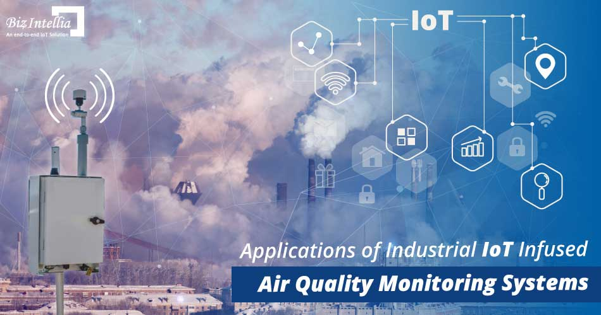
Objectives:
Eliminating bad storage smell from environment.
Helps in maintaining the environment fresh.
Enhancing product quality and shelf life.

Slide 6

Methodology used
To develop an Air Quality Monitoring System (AQMS) that addresses the goals of eliminating bad storage smells, maintaining a fresh environment, enhancing product quality and shelf life.
Firstly, Conduct a comprehensive analysis of the storage environment, considering factors such as temperature, humidity, airflow, and presence of pollutants or odors. Gather requirements specific to eliminating bad smells, improving air quality, and ensuring compliance with NHB ventilation standards.

Slide 7
Methodology
Secondly, select sensors such as VOC(volatile organic compounds), choose IOT platform then integration with Ventilation Systems(NHB).
Then develop algorithm to analyze sensor data detect patterns associated with bad smells, pollutant levels, temperature variations, and humidity fluctuations.
this methodology, can develop and deploy an effective Air Quality Monitoring System tailored to the specific needs of eliminating bad storage smells, improving product quality, extending shelf life, and meeting NHB ventilation standards.

Slide 8
Results and Outputs
the results and outputs of the AQMS provide actionable information and decision support tools for stakeholders to proactively manage air quality, product quality, and ventilation compliance within storage facilities or production environments.
It provide Real-time Air Quality Data.
It provide Alerts and Notifications.
It provide Odor Detection and Management.
It provide quality Product and Shelf Life Insights.

Slide 9
Conclusion
In conclusion, the AQMS serves as a vital tool for maintaining a healthy, fresh environment, preserving product integrity, and ensuring compliance with ventilation standards, ultimately contributing to the overall success and sustainability of storage facilities and production environments.

Slide 10

Future Scope
the future scope for the AQMS is characterized by continuous innovation, integration of advanced technologies, and alignment with sustainable practices, aiming to create healthier, more productive, and environmentally-friendly indoor spaces.

